Slide 1
Dynamic programming
David Kauchak CS 140 – Spring 2024

Slide 2
Admin
Assignment 4
Group 4 distribution

Slide 3
Knapsack problems: Greedy or not?
0-1 Knapsack – A thief robbing a store finds n items worth v₁, v₂, .., v_{n} dollars and weight w₁, w₂, …, w_{n} pounds, where v_{i} and w_{i} are integers. The thief can carry at most W pounds in the knapsack. Which items should the thief take if they want to maximize value.
Fractional knapsack problem – Same as above, but the thief happens to be at the bulk section of the store and can carry fractional portions of the items. For example, the thief could take 20% of item i for a weight of 0.2w_{i} and a value of 0.2v_{i}.

Slide 4
Algorithmic "techniques"
Iterative/incremental: solve problem of size n by first solving problem of size n-1.
Divide-and-conquer: divide problem into independent subproblems. Solve each subproblem independently. Combine solutions to subproblem to create solution to the original problem.
Greedy: make locally optimal choice and repeat on remaining subproblem.

Slide 5
Algorithmic "techniques"
Iterative/incremental: solve problem of size n by first solving problem of size n-1.
Divide-and-conquer: divide problem into independent subproblems. Solve each subproblem independently. Combine the solutions to subproblem to create solution to the original problem.

Slide 6
Dynamic programming
Method for solving problems where optimal solutions can be defined in terms of optimal solutions to subproblems
AND
the subproblems are overlapping

Slide 7
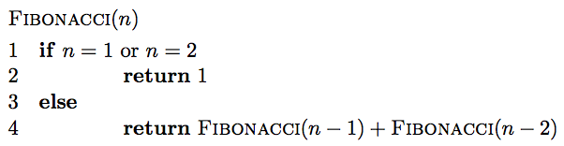
Fibonacci: a first attempt

Slide 8
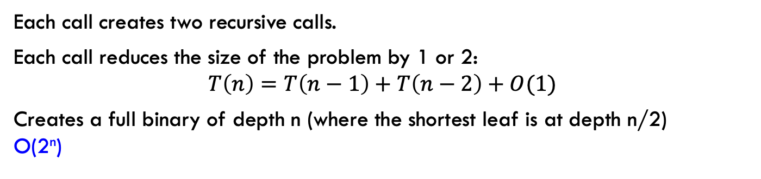
Running time
Each call creates two recursive calls.
Each call reduces the size of the problem by 1 or 2: $$T\left(n\right)=T\left(n−1\right)+T\left(n−2\right)+O(1)$$
Creates a full binary of depth n (where the shortest leaf is at depth n/2) O(2^{n})

Slide 9
Can we do better?
Fib(n)
Fib(n-1)
Fib(n-2)
Fib(n-2)
Fib(n-3)
Fib(n-3)
Fib(n-4)
Fib(n-3)
Fib(n-4)
Fib(n-4)
Fib(n-5)
Fib(n-4)
Fib(n-5)
Fib(n-5)
Fib(n-6)

Slide 10
A lot of repeated work!
Fib(n)
Fib(n-1)
Fib(n-2)
Fib(n-2)
Fib(n-3)
Fib(n-3)
Fib(n-4)
Fib(n-3)
Fib(n-4)
Fib(n-4)
Fib(n-5)
Fib(n-4)
Fib(n-5)
Fib(n-5)
Fib(n-6)

Slide 11
Identifying a dynamic programming problem
The solution can be defined with respect to solutions to sub-problems.
The sub-problems created are overlapping, that is we see the same sub-problems repeated.

Slide 12
Overlapping sub-problems
divide and conquer
dynamic
programming
…

Slide 13
Dynamic programming: steps
1a) optimal substructure: optimal solutions to the problem incorporate optimal solutions to related subproblems
convince yourself that there is optimal substructure
1b) recursive definition: use this to recursively define the value of an optimal solution
2) DP solution: describe the dynamic programming table:
size, initial values, order in which it’s filled in, location of solution
3) Analysis: analyze space requirements, running time

Slide 14
1a: optimal substructure
optimal solutions to a problem incorporate optimal solutions to subproblems
?

Slide 15
1a: optimal substructure
optimal solutions to a problem incorporate optimal solutions to subproblems
Sometimes the problem setup/structure meets the optimal substructure criteria by definition

Slide 16
1b: recursive definition
Define a function and clearly define the inputs to the function
The function definition should be recursive with respect to multiple subproblems
pretend like you have a working function, but it only works on smaller problems
Key: subproblems will be overlapping, i.e., inputs to subproblems will not be disjoint

Slide 17
1b: recursive definition
Fibonacci:
F(n) = ?

Slide 18
1b: recursive definition
Fibonacci:
F(n) = F(n-1) + F(n-2)

Slide 19
2: DP solution
The recursive solution will generally be top-down, i.e., working from larger problems to smaller
DP solution:
work bottom-up, from the smallest versions of the problem to the largest
store the answers to subproblems in a table (often an array or matrix)
to build bigger problems, lookup solutions in the table to subproblems

Slide 20
2: DP solution
F(n) = F(n-1) + F(n-2)
What are the smallest possible values (subproblems)?
To calculate F(n), what are all the subproblems we need to calculate? This is the “table”.
How should we fill in the table?

Slide 21
2: DP solution
F(n) = F(n-1) + F(n-2)
What are the smallest possible values (subproblems)? F(1) = 1, F(2) = 1
To calculate F(n), what are all the subproblems we need to calculate? This is the “table”. F(1) … F(n-1)
How should we fill in the table? F(1) → F(n)

Slide 22
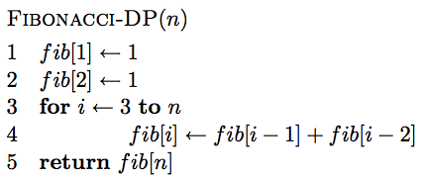
2: DP solution
Store the intermediary values in an array (fib)

Slide 23
3: Analysis
Space requirements?
Running time?

Slide 24
3: Analysis
Space requirements: Θ(n)
Running time: Θ(n)

Slide 25
Counting binary search trees
How many unique binary search trees can be created using the numbers 1 through n?
4
2
5
1
3
6

Slide 26
Step 1: What is the subproblem?
Assume we have a working function (call it T) that can give us the answer to smaller subproblems.
How can we use the answer from this to answer our question?
How many options for the root are there?
1
2
3
n
…

Slide 27
Subproblems
i
How many trees have i as the root?

Slide 28
Subproblems
i
1, 2, …, i-1
i+1, i+2, …, n
?

Slide 29
Subproblems
i
1, 2, …, i-1
i+1, i+2, …, n
T(i-1)
?
subproblem of size i-1

Slide 30
Subproblems
i
1, 2, …, i-1
i+1, i+2, …, n
T(i-1)
Number of trees for i+1, i+2, …, i+n is the same as the number of trees from 1, 2, …, n-i
subproblem of size i-1

Slide 31
Subproblems
i
1, 2, …, i-1
i+1, i+2, …, n
T(i-1)
T(n-i)
subproblem of size i-1
subproblem of size n-i

Slide 32
1a: optimal substructure
optimal solutions to a problem incorporate optimal solutions to related subproblems
i
T(i-1)
T(n-i)
?

Slide 33
1a: optimal substructure
optimal solutions to a problem incorporate optimal solutions to related subproblems
i
T(i-1)
T(n-i)
By the definition of binary trees: binary trees are recursive structures.

Slide 34
1b: recursive definition
i
1, 2, …, i-1
i+1, i+2, …, n
T(i-1)
T(n-i)
Given solutions for T(i-1) and T(n-i) how many trees are there with i as the root?

Slide 35
1b: recursive definition
i
1, 2, …, i-1
i+1, i+2, …, n
T(i-1)
T(n-i)
Trees with i as root = T(i-1) * T(n-i)
Answer: This is a result of the fact that each tree from the left can be combined with each tree from the right to form a unique BST with i as the root.

Slide 36
1b: recursive definition
Trees with i as root = T(i-1) * T(n-i)
How many trees total?
1
2
3
n
…

Slide 37
1b: recursive definition
Trees with i as root = T(i-1) * T(n-i)
1
2
3
n
…

Slide 38
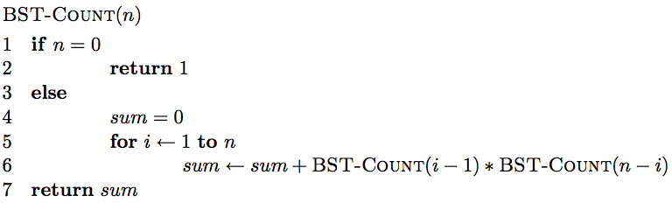
A recursive implementation
Like with Fibonacci, we’re repeating a lot of work.

Slide 39
2: DP solution (from the bottom-up)
What are the smallest possible subproblems?
To calculate T(n), what are all the subproblems we need to calculate? This is the “table”.
How should we fill in the table?

Slide 40
2: DP solution (from the bottom-up)
What are the smallest possible subproblems?
T(0)=1, T(1) = 1
Why do we need T(0) and why is it 1?

Slide 41
2: DP solution (from the bottom-up)
What are the smallest possible subproblems?
T(0)=1, T(1) = 1
1
Need to think carefully about base cases/edge cases

Slide 42
2: DP solution (from the bottom-up)
What are the smallest possible subproblems?
T(0)=1, T(1) = 1
To calculate T(n), what are all the subproblems we need to calculate? This is the “table”. T(0) … T(n-1)
How should we fill in the table? T(0) → T(n)

Slide 43
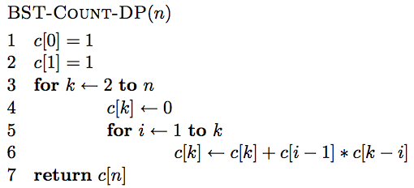
2: DP solution (from the bottom-up)

Slide 44
Fill in the first 4 values
0 1 2 3 4 5 … n

Slide 45
1 1
0 1 2 3 4 5 … n

Slide 46
c[0]*c[1] + c[1]*c[0]
1 1
0 1 2 3 4 5 … n

Slide 47
1
2
2
1
c[0]*c[1] + c[1]*c[0]
1 1
0 1 2 3 4 5 … n

Slide 48
1 1 2
0 1 2 3 4 5 … n

Slide 49
1
2
3
c[0]*c[2] + c[1]*c[1] + c[2]*c[0]
1 1 2
0 1 2 3 4 5 … n

Slide 50
1 1 2 5
0 1 2 3 4 5 … n

Slide 51
1 1 2 5 …
0 1 2 3 4 5 … n

Slide 52
3: Analysis
Space requirements?
Running time?

Slide 53
3: Analysis
Space requirements: Θ(n)
Running time: Θ(n²)

Slide 54
Subsequences
For a sequence X = x₁, x₂, …, x_{n}, a subsequence is a subset of the sequence defined by a set of increasing indices (i₁, i₂, …, i_{k}) where 1 ≤ i₁ < i₂ < … < i_{k} ≤ n
X = A B A C D A B A B
ABA?

Slide 55
Subsequences
For a sequence X = x₁, x₂, …, x_{n}, a subsequence is a subset of the sequence defined by a set of increasing indices (i₁, i₂, …, i_{k}) where 1 ≤ i₁ < i₂ < … < i_{k} ≤ n
X = A B A C D A B A B
ABA

Slide 56
Subsequences
For a sequence X = x₁, x₂, …, x_{n}, a subsequence is a subset of the sequence defined by a set of increasing indices (i₁, i₂, …, i_{k}) where 1 ≤ i₁ < i₂ < … < i_{k} ≤ n
X = A B A C D A B A B
ACA?

Slide 57
Subsequences
For a sequence X = x₁, x₂, …, x_{n}, a subsequence is a subset of the sequence defined by a set of increasing indices (i₁, i₂, …, i_{k}) where 1 ≤ i₁ < i₂ < … < i_{k} ≤ n
X = A B A C D A B A B
ACA

Slide 58
Subsequences
For a sequence X = x₁, x₂, …, x_{n}, a subsequence is a subset of the sequence defined by a set of increasing indices (i₁, i₂, …, i_{k}) where 1 ≤ i₁ < i₂ < … < i_{k} ≤ n
X = A B A C D A B A B
DCA?

Slide 59
Subsequences
For a sequence X = x₁, x₂, …, x_{n}, a subsequence is a subset of the sequence defined by a set of increasing indices (i₁, i₂, …, i_{k}) where 1 ≤ i₁ < i₂ < … < i_{k} ≤ n
X = A B A C D A B A B
DCA

Slide 60
Subsequences
For a sequence X = x₁, x₂, …, x_{n}, a subsequence is a subset of the sequence defined by a set of increasing indices (i₁, i₂, …, i_{k}) where 1 ≤ i₁ < i₂ < … < i_{k} ≤ n
X = A B A C D A B A B
AADAA?

Slide 61
Subsequences
For a sequence X = x₁, x₂, …, x_{n}, a subsequence is a subset of the sequence defined by a set of increasing indices (i₁, i₂, …, i_{k}) where 1 ≤ i₁ < i₂ < … < i_{k} ≤ n
X = A B A C D A B A B
AADAA

Slide 62
Longest common subsequence (LCS)
Given two sequences X and Y, a common subsequence is a subsequence that occurs in both X and Y
Given two sequences X = x₁, x₂, …, x_{n} and Y = y₁, y₂, …, y_{n}
What is the longest common subsequence?

Slide 63
LCS problem
Given two sequences X and Y, a common subsequence is a subsequence that occurs in both X and Y
Given two sequences X = x₁, x₂, …, x_{n} and Y = y₁, y₂, …, y_{n}
What is the longest common subsequence?
X = A B C B D A B
Y = B D C A B A

Slide 64
LCS problem
Given two sequences X and Y, a common subsequence is a subsequence that occurs in both X and Y
Given two sequences X = x₁, x₂, …, x_{n} and Y = y₁, y₂, …, y_{n}
What is the longest common subsequence?
X = A B C B D A B
Y = B D C A B A

Slide 65
1a: optimal substructure
optimal solutions to a problem incorporate optimal solutions to subproblems
Often a proof by contradiction:
Show: optimal solutions incorporate optimal solutions to subproblems
Assume the optimal solution does not contain optimal solutions to subproblems
Show this leads to a contradiction (often that we could create a better solution using the solution to the subproblem)

Slide 66
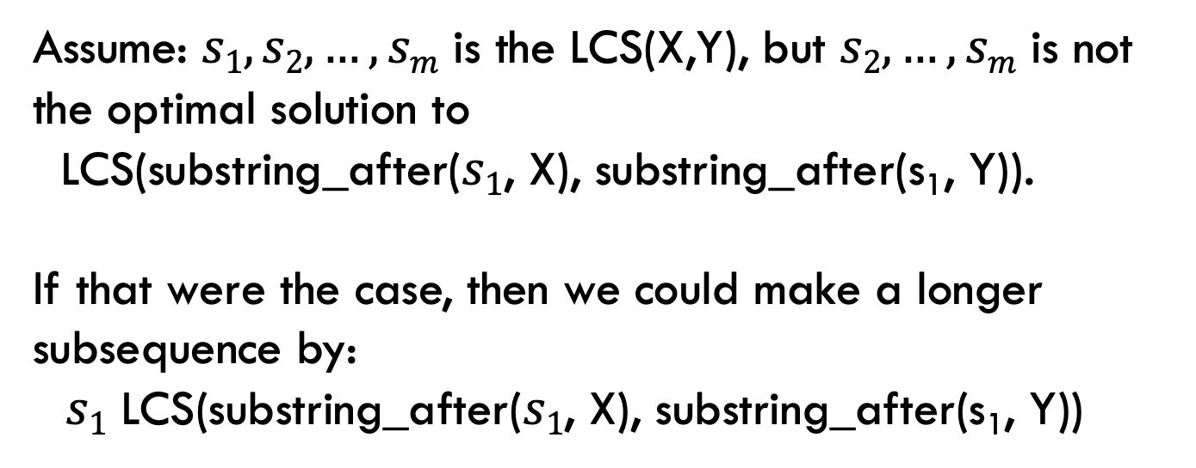
1a: optimal substructure
Prove: optimal solutions to the problem incorporate optimal solutions to related subproblems
Proof by contradiction:
Assume: $s1, s2, …, sm$ is the LCS(X,Y), but $s2, …, sm$ is not the optimal solution to
LCS(substring_after($s1$, X), substring_after(s₁, Y)).
If that were the case, then we could make a longer subsequence by:
$s1$ LCS(substring_after($s1$, X), substring_after(s₁, Y))
contradiction

Slide 67
1b: recursive solution
X = A B C B D A B
Y = B D C A B A
Assume you have a solver for smaller problems

Slide 68
1b: recursive solution
X = A B C B D A ?
Y = B D C A B ?
Is the last character part of the LCS?

Slide 69
1b: recursive solution
X = A B C B D A ?
Y = B D C A B ?
Two cases: either the characters are the same or they’re different

Slide 70
1b: recursive solution
X = A B C B D A A
LCS
The characters are part of the LCS
Y = B D C A B A
What is the recursive relationship?
If they’re the same

Slide 71
1b: recursive solution
X = A B C B D A B
LCS
Y = B D C A B A
If they’re different

Slide 72
1b: recursive solution
X = A B C B D A B
LCS
Y = B D C A B A
If they’re different

Slide 73
1b: recursive solution
X = A B C B D A B
Y = B D C A B A
?
X = A B C B D A B
Y = B D C A B A
If they’re different

Slide 74
1b: recursive solution
X = A B C B D A B
Y = B D C A B A
(for now, let’s just worry about counting the length of the LCS)

Slide 75
2: DP solution
What types of sub-problem solutions do we need to store?
LCS(X_{1…j}, Y_{1…k})
two different indices

Slide 76
2: DP solution
What types of sub-problem solutions do we need to store?
LCS(X_{1…j}, Y_{1…k})

Slide 77
j
0 1 2 3 4 5 6 y_{j} B D C A B A
i
0 x_{i} 1 A 2 B 3 C 4 B 5 D 6 A 7 B
For Fibonacci and tree counting, we had to initialize some entries in the array. Any here?

Slide 78
j
0 1 2 3 4 5 6 y_{j} B D C A B A
i
0 x_{i} 1 A 2 B 3 C 4 B 5 D 6 A 7 B
0 0 0 0 0 0 0 0 0 0 0 0 0 0
Need to initialize values within 1 smaller in either dimension.

Slide 79
j
0 1 2 3 4 5 6 y_{j} B D C A B A
i
0 x_{i} 1 A 2 B 3 C 4 B 5 D 6 A 7 B
0 0 0 0 0 0 0 0 0 0 0 0 0 0
How should we fill in the table?

Slide 80
j
0 1 2 3 4 5 6 y_{j} B D C A B A
i
0 x_{i} 1 A 2 B 3 C 4 B 5 D 6 A 7 B
0 0 0 0 0 0 0 0 0 0 ? 0 0 0 0
To fill in an entry, we may need to look:
up one
left one
diagonal up and left
Just need to make sure these exist.

Slide 81
j
0 1 2 3 4 5 6 y_{j} B D C A B A
i
0 x_{i} 1 A 2 B 3 C 4 B 5 D 6 A 7 B
0 0 0 0 0 0 0 0 ? 0 0 0 0 0 0
LCS(A, B)

Slide 82
j
0 1 2 3 4 5 6 y_{j} B D C A B A
i
0 x_{i} 1 A 2 B 3 C 4 B 5 D 6 A 7 B
0 0 0 0 0 0 0 0 0 0 0 0 0 0 0

Slide 83
j
0 1 2 3 4 5 6 y_{j} B D C A B A
i
0 x_{i} 1 A 2 B 3 C 4 B 5 D 6 A 7 B
0 0 0 0 0 0 0 0 0 0 0 ? 0 0 0 0 0 0
LCS(A, BDCA)

Slide 84
j
0 1 2 3 4 5 6 y_{j} B D C A B A
i
0 x_{i} 1 A 2 B 3 C 4 B 5 D 6 A 7 B
0 0 0 0 0 0 0 0 0 0 0 1 0 0 0 0 0 0
LCS(A, BDCA)

Slide 85
j
0 1 2 3 4 5 6 y_{j} B D C A B A
i
0 x_{i} 1 A 2 B 3 C 4 B 5 D 6 A 7 B
0 0 0 0 0 0 0 0 0 0 0 1 1 1 0 1 1 1 1 2 2 0 1 1 2 2 2 2 0 1 1 2 2 ? 0 0 0
LCS(ABCB, BDCAB)

Slide 86
j
0 1 2 3 4 5 6 y_{j} B D C A B A
i
0 x_{i} 1 A 2 B 3 C 4 B 5 D 6 A 7 B
0 0 0 0 0 0 0 0 0 0 0 1 1 1 0 1 1 1 1 2 2 0 1 1 2 2 2 2 0 1 1 2 2 3 0 0 0
LCS(ABCB, BDCAB)

Slide 87
j
0 1 2 3 4 5 6 y_{j} B D C A B A
i
0 x_{i} 1 A 2 B 3 C 4 B 5 D 6 A 7 B
0 0 0 0 0 0 0 0 0 0 0 1 1 1 0 1 1 1 1 2 2 0 1 1 2 2 2 2 0 1 1 2 2 3 3 0 1 2 2 2 3 3 0 1 2 2 3 3 4 0 1 2 2 3 4 4
Where’s the final answer?

Slide 88
j
0 1 2 3 4 5 6 y_{j} B D C A B A
i
Space requirements?
Running time?
0 x_{i} 1 A 2 B 3 C 4 B 5 D 6 A 7 B
0 0 0 0 0 0 0 0 0 0 0 1 1 1 0 1 1 1 1 2 2 0 1 1 2 2 2 2 0 1 1 2 2 3 3 0 1 2 2 2 3 3 0 1 2 2 3 3 4 0 1 2 2 3 4 4

Slide 89
j
0 1 2 3 4 5 6 y_{j} B D C A B A
i
Space requirements: Θ(nm)
Running time: Θ(nm)
0 x_{i} 1 A 2 B 3 C 4 B 5 D 6 A 7 B
0 0 0 0 0 0 0 0 0 0 0 1 1 1 0 1 1 1 1 2 2 0 1 1 2 2 2 2 0 1 1 2 2 3 3 0 1 2 2 2 3 3 0 1 2 2 3 3 4 0 1 2 2 3 4 4

Slide 90
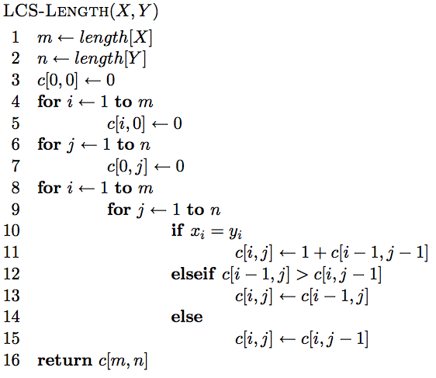
The algorithm

Slide 91
The algorithm
Base case initialization

Slide 92
The algorithm
Fill in the matrix

Slide 93
The algorithm

Slide 94
The algorithm

Slide 95
The algorithm

Slide 96
Keeping track of the solution
Our LCS algorithm only calculated the length of the LCS between X and Y
What if we wanted to know the actual sequence?

Slide 97
j
0 1 2 3 4 5 6 y_{j} B D C A B A
i
0 x_{i} 1 A 2 B 3 C 4 B 5 D 6 A 7 B
0 0 0 0 0 0 0 0 0 0 0 1 1 1 0 1 1 1 1 2 2 0 1 1 2 2 2 2 0 1 1 2 2 ? 0 0 0
LCS(ABCB, BDCAB)

Slide 98
j
0 1 2 3 4 5 6 y_{j} B D C A B A
i
0 x_{i} 1 A 2 B 3 C 4 B 5 D 6 A 7 B
0 0 0 0 0 0 0 0 0 0 0 1 1 1 0 1 1 1 1 2 2 0 1 1 2 2 2 2 0 1 1 2 2 3 0 0 0
LCS(ABCB, BDCAB)

Slide 99
j
0 1 2 3 4 5 6 y_{j} B D C A B A
i
0 x_{i} 1 A 2 B 3 C 4 B 5 D 6 A 7 B
0 0 0 0 0 0 0 0 0 0 0 1 1 1 0 1 1 1 1 2 2 0 1 1 2 2 2 2 0 1 1 2 2 3 ? 0 0 0
LCS(ABCB, BDCABA)

Slide 100
j
0 1 2 3 4 5 6 y_{j} B D C A B A
i
0 x_{i} 1 A 2 B 3 C 4 B 5 D 6 A 7 B
0 0 0 0 0 0 0 0 0 0 0 1 1 1 0 1 1 1 1 2 2 0 1 1 2 2 2 2 0 1 1 2 2 3 3 0 0 0
LCS(ABCB, BDCABA)

Slide 101
j
0 1 2 3 4 5 6 y_{j} B D C A B A
i
0 x_{i} 1 A 2 B 3 C 4 B 5 D 6 A 7 B
0 0 0 0 0 0 0 0 0 0 0 1 1 1 0 1 1 1 1 2 2 0 1 1 2 2 2 2 0 1 1 2 2 3 3 0 1 2 2 2 3 3 0 1 2 2 3 3 4 0 1 2 2 3 4 4
How do we generate the solution from this?

Slide 102
j
0 1 2 3 4 5 6 y_{j} B D C A B A
i
0 x_{i} 1 A 2 B 3 C 4 B 5 D 6 A 7 B
0 0 0 0 0 0 0 0 0 0 0 1 1 1 0 1 1 1 1 2 2 0 1 1 2 2 2 2 0 1 1 2 2 3 3 0 1 2 2 2 3 3 0 1 2 2 3 3 4 0 1 2 2 3 4 4
We can follow the arrows to generate the solution
BCBA

